Slide 1

Graph Theory and Its Applications PageRank
Dr. Arti Arya
Department of Computer Science Engineering

Slide 2

Graph Theory and its Applications UE21CS343AB3 Disclaimer
The inputs to the slides are by Prof. BhaskarJyoti and Dr. Arti Arya. Also, various additional inputs are added from various reliable resources from Foreign and Indian Universities as well as from sites.
Notes:
Ok. Having said that, lets get back to what we were speaking about.
Input devices. We have seen that the virtual reality eco system largely encompasses three fundamental components that include
HMD – head mounted devices that give you immersive VR experience, we saw some examples in the last class like the HTC VIVE, Oculus Rift, Samsung gear and so on. Some of you have also used few of these and experienced it for a few minutes.
And the second components is the GTD or the Gesture Tracking Devices. We saw a video of Xsense IMU sensors that can accurately estimation the position and orientation of a dancer. we will in the next hour see how these gesture tracking devices work and what are the various technicalities that go into tracking. I will try to keep it as non-mathematical as possible, as the mathematics behind it can get pretty messy and complicated. However, if you are interested in the mathematical aspects, I will be more than happy to discuss.
On the screen you can see that a 3 directional coordinate system is depicted. The 3 primary axes of a 3d coordinate system is X, Y and Z axis. Hear I would like to know where, when and why in your past have you encountered 3 dimensional coordinate system.
Give some time to the students to ponder on
Ok, if I tell you, I have encountered 2 dimension in images, drawings, sketch and so on. While I have encountered 1 dimension when I want to know the temperature currently or current time or something like that. Similar, where and when have you encountered 3D, either consciously or subconsciously.
Explain the roll pitch and yaw concepts.
Degree of freedom

Slide 3

Graph Theory and its Applications UE21CS343AB3
Random Surfer Model
PageRank can be thought of as a model of user behavior.
Initially every web page is chosen uniformly at random
With probability α, choose a hyperlink on page ( adjacent neighbor)
With probability 1- α, perform random walk on web by randomly choosing a node and then restart the web surfing at step 1
Note : we develop this in two parts i.e. basic PR update rule and Scaled PR update rule

Slide 4
Graph Theory and its Applications UE21CS343AB3
Steady State in vector notation and PageRank
The steady state in vector notation is simply a vector
p = (p1, p2, ..., pN) of probabilities.
p is the long-term visit rate (or PageRank) of page i.
In the steady state, each page has a long-term visit rate.
This long-term visit rate is the page’s PageRank.
PageRank = long-term visit rate = steady state probability
So, we can think of PageRank as a very long vector – one
entry per page.

Slide 5
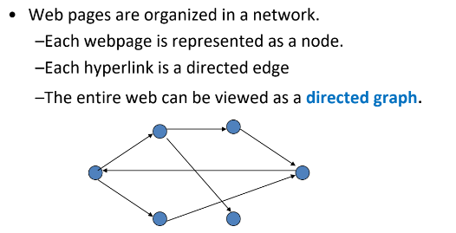

Graph Theory and its Applications UE21CS343AB3
Steady State in vector notation and PageRank

Slide 6
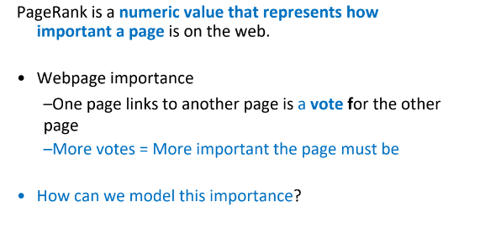
Graph Theory and its Applications UE21CS343AB3
PageRank

Slide 7
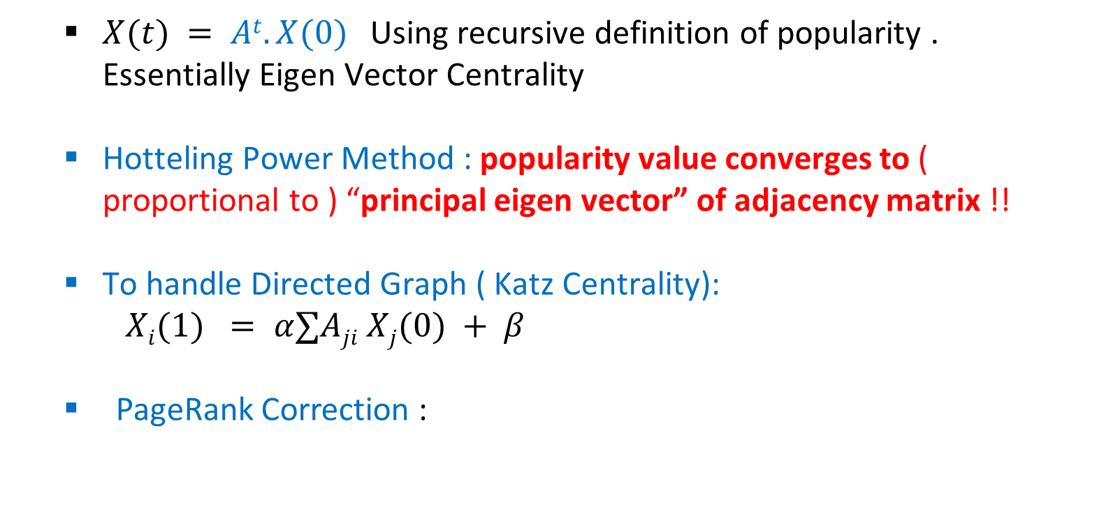
Graph Theory and its Applications UE21CS343AB3
Recap : Spectral Analysis
$X(t) = At.X(0)$Using recursive definition of popularity . Essentially Eigen Vector Centrality
Hotteling Power Method : popularity value converges to ( proportional to ) “principal eigen vector” of adjacency matrix !!
To handle Directed Graph ( Katz Centrality):
$Xi(1) = α∑Aji Xj(0) + β$
PageRank Correction :

Slide 8
Graph Theory and its Applications UE21CS343AB3
Page Rank
PageRank is a kind of “fluid”:
– It circulates through the network
– Is passing from node to node across edges
– Is pooling at the nodes that are the most important
• Total PageRank in the network remains constant – Why?
– Each page takes its PageRank, divides it up, and passes it along links
– PageRank is never created nor destroyed, just moved around from one node to another
• No need to normalize PageRank of nodes to prevent them from growing

Slide 9
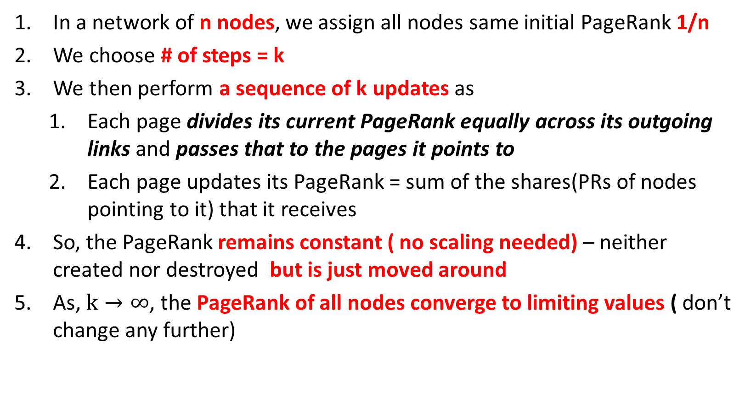
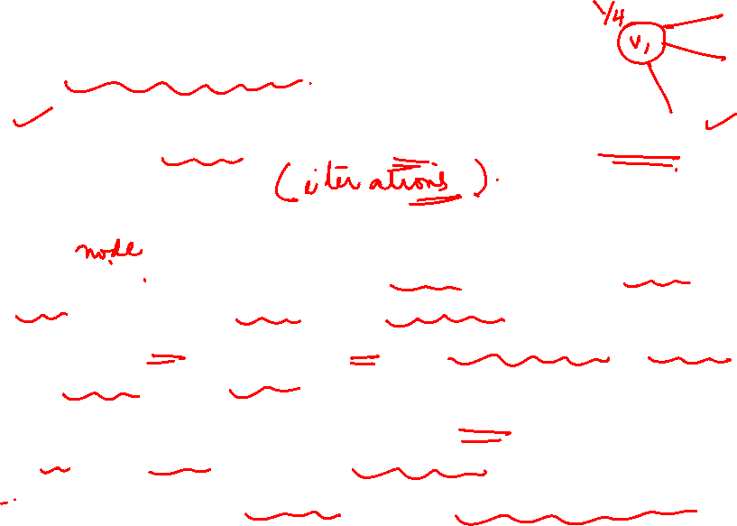
Graph Theory and its Applications UE21CS343AB3
Basic Page Rank Update Rule
In a network of n nodes, we assign all nodes same initial PageRank 1/n
We choose # of steps = k
We then perform a sequence of k updates as
Each page divides its current PageRank equally across its outgoing links and passes that to the pages it points to
Each page updates its PageRank = sum of the shares(PRs of nodes pointing to it) that it receives
So, the PageRank remains constant ( no scaling needed) – neither created nor destroyed but is just moved around
As, $k→∞$, the PageRank of all nodes converge to limiting values ( don’t change any further)

Slide 10
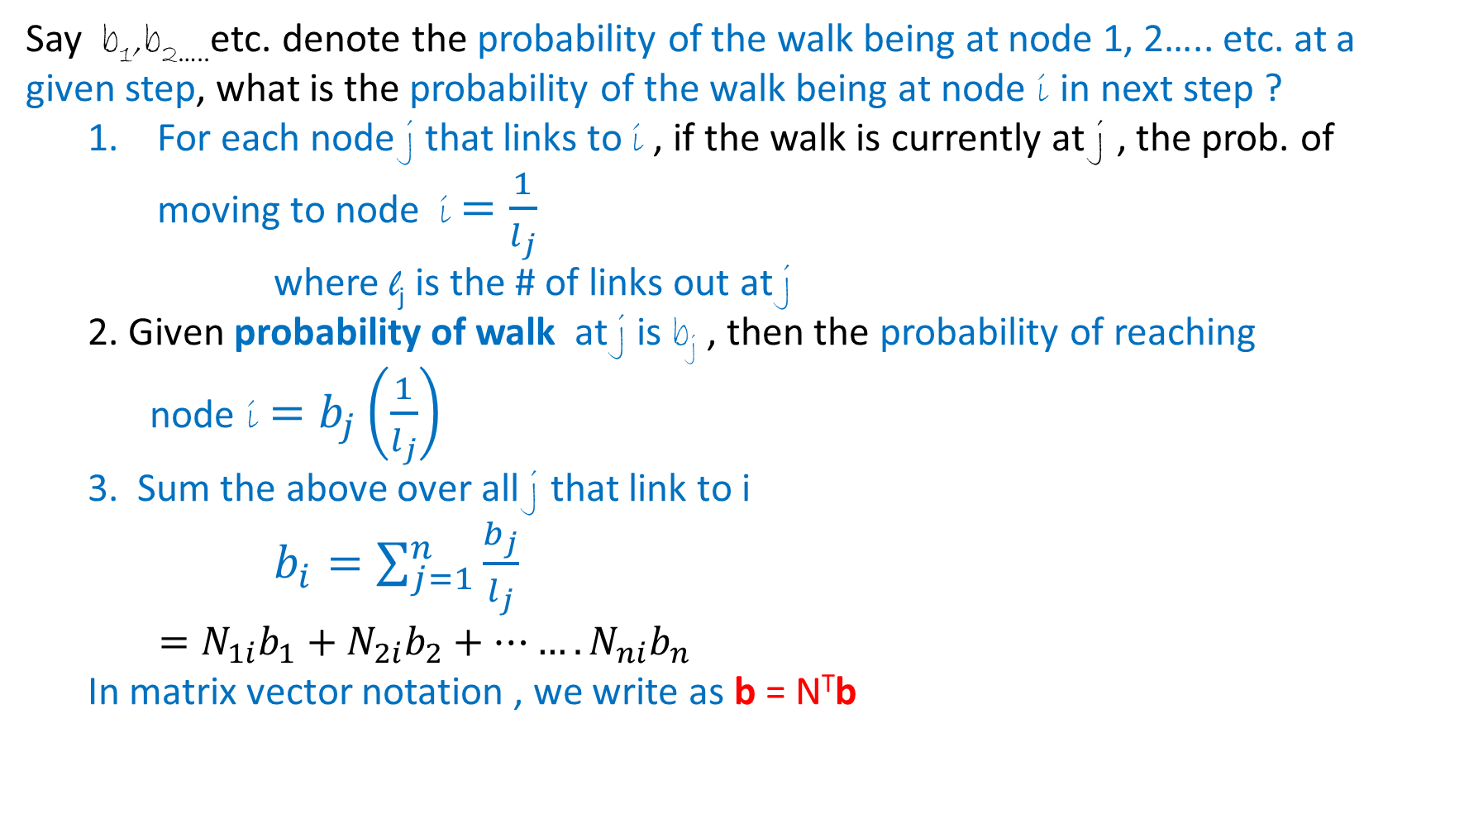
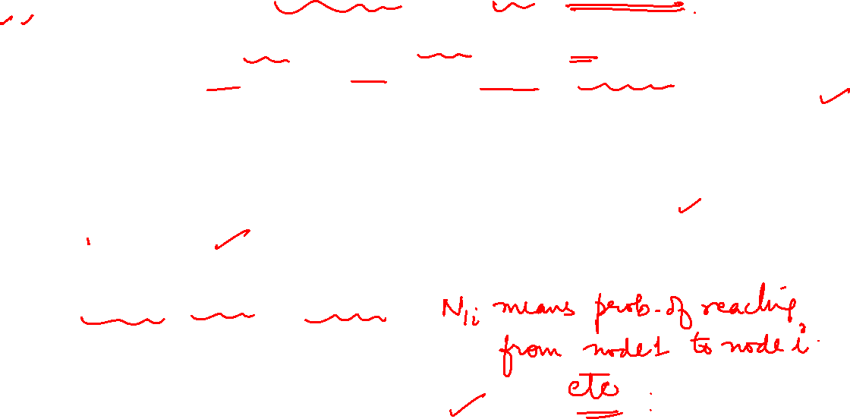
Graph Theory and its Applications UE21CS343AB3
Intuitive Formulation Of PageRank Using Random Walk –Basic PR update Rule
Say b₁,b_{2…..}etc. denote the probability of the walk being at node 1, 2….. etc. at a given step, what is the probability of the walk being at node i in next step ?
For each node j that links to i , if the walk is currently at j , the prob. of moving to node i $=\frac{1}{l_{j}}$
where l_{j} is the # of links out at j
2. Given probability of walk at j is b_{j} , then the probability of reaching node i $=b_{j}\left(\frac{1}{l_{j}}\right)$
3. Sum the above over all j that link to i
$b_{i}=\sum_{j=1}^{n}{\frac{b_{j}}{l_{j}}}$
$=N_{1i}b_{1}+N_{2i}b_{2}+…….N_{ni}b_{n}$
In matrix vector notation , we write as b = N^{T}b
j
l_{j}
i

Slide 11
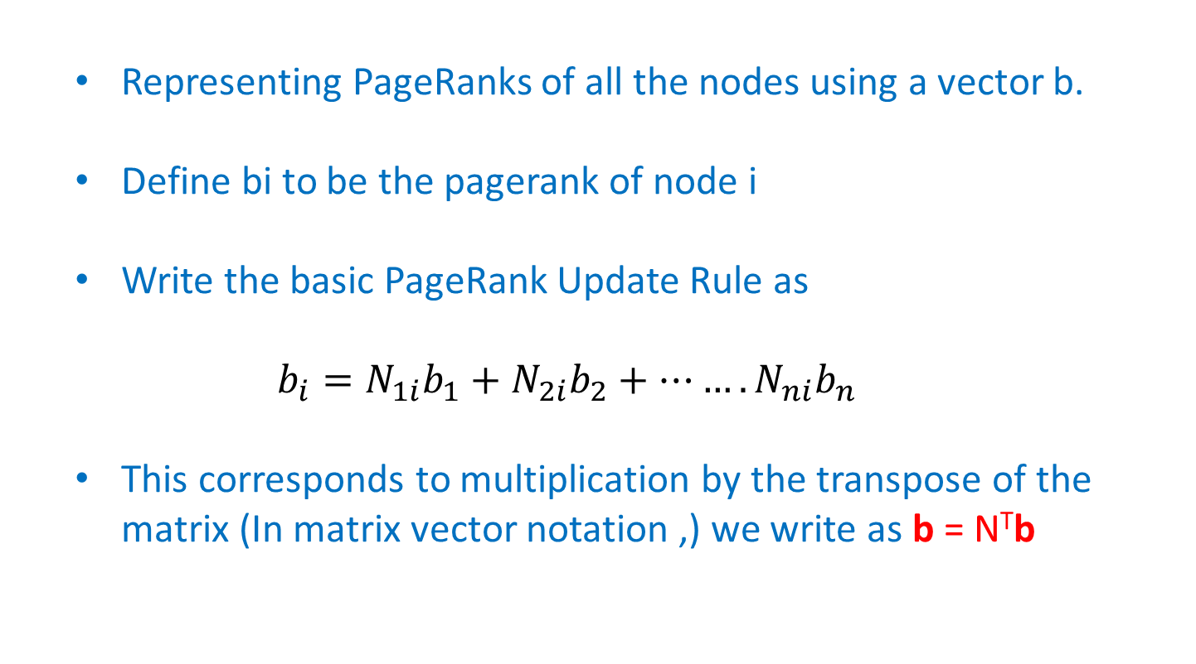

Graph Theory and its Applications UE21CS343AB3
Spectral Analysis of PageRank
Representing PageRanks of all the nodes using a vector b.
Define bi to be the pagerank of node i
Write the basic PageRank Update Rule as
$$b_{i}=N_{1i}b_{1}+N_{2i}b_{2}+…….N_{ni}b_{n}$$
This corresponds to multiplication by the transpose of the matrix (In matrix vector notation ,) we write as b = N^{T}b
j
l_{j}
i
PageRank values and random-walk probabilities start the same (initially 1/n) and are updated with the same rule

Slide 12
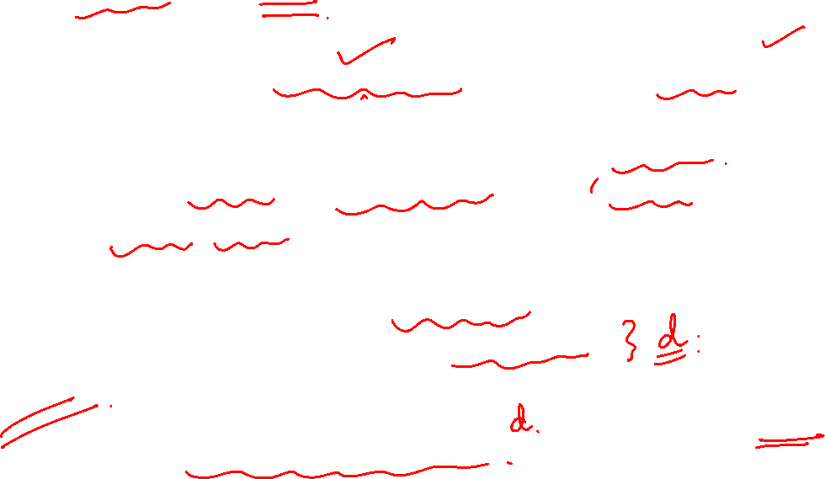
Graph Theory and its Applications UE21CS343AB3
Scaled Page Rank Update Rule
Firstly, apply basic PR update rule and secondly scale down all PR values by a factor of d( chosen between 0 and 1)
Total PageRank in the network has shrunk from 1 to d.
Divide the (1-d) residual units of PR equally all over the n nodes giving
(1-d)/n to each.
It can be proven that values converge again.
Scaling factor usually chosen between 0.8 and 0.9
Its like “water cycle” that evaporates 1 − s units of PageRank in each step and rains it down uniformly across all nodes

Slide 13
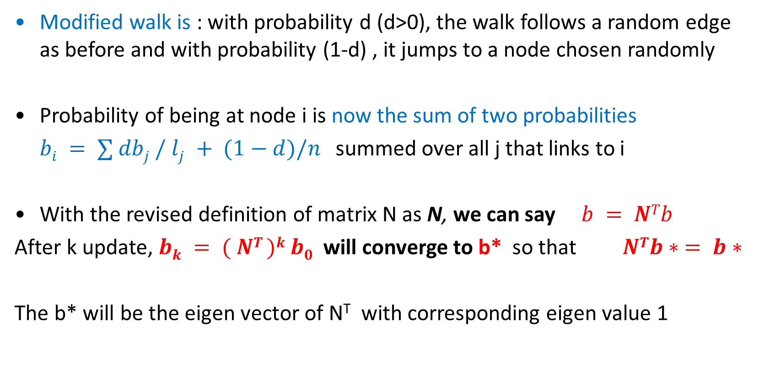
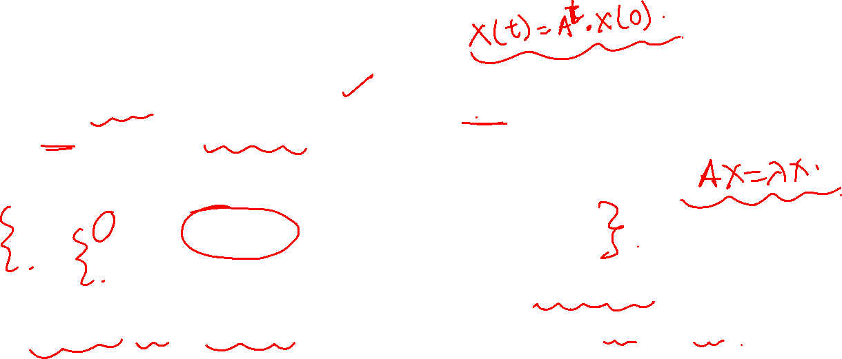
Graph Theory and its Applications UE21CS343AB3
Scaled Version Of Random walk
Modified walk is : with probability d (d>0), the walk follows a random edge as before and with probability (1-d) , it jumps to a node chosen randomly
Probability of being at node i is now the sum of two probabilities
$bi = ∑ dbj / lj + (1−d)/n$summed over all j that links to i
With the revised definition of matrix N as N, we can say $b = NTb$
After k update, $bk = ( NT )k b0$ will converge to b* so that $NTb∗ = b∗$
The b* will be the eigen vector of N^{T} with corresponding eigen value 1

Slide 14

Graph Theory and its Applications UE21CS343AB3
Why Does the PageRank Converge?
Perron Frobenius Theorem states for any matrix M on which all entries are positive and it is a stochastic matrix,
largest eigenvalue c=1 such that c > |c’| for all other eigen values c’
1 is an eigen value with multiplicity 1
For the eigen value 1: there exists a unique eigen vector where the sum of the elements = 1
For any starting vector x ≠ 0, the sequence vector M^{k}x converges to an eigenvector x corresponding to the largest eigenvalue c = 1 as k -> ∞

Slide 15
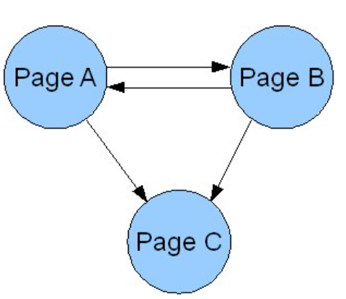
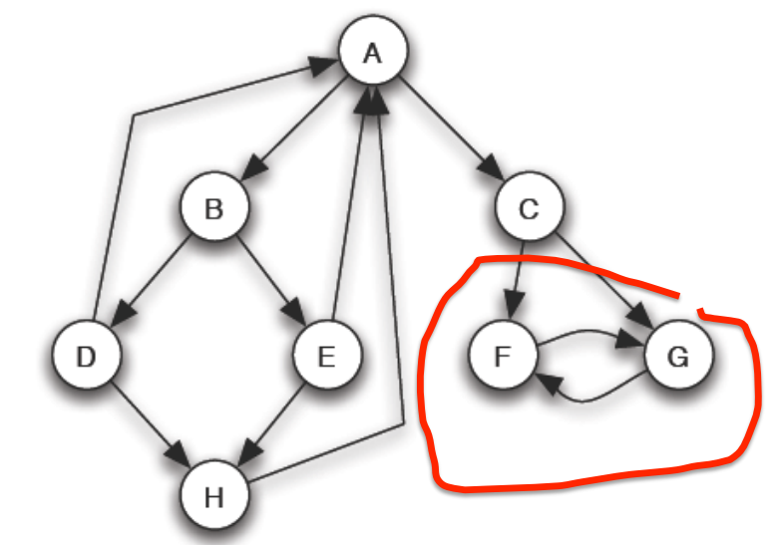
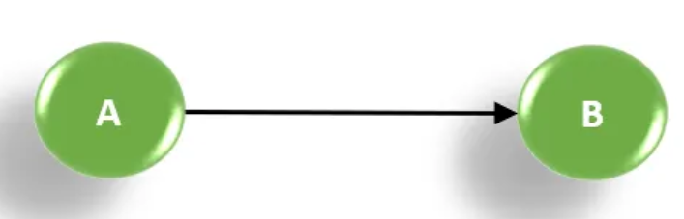

Graph Theory and its Applications UE21CS343AB3
Limitations Of Early (Basic ) PageRank
Rank Sinks or leak. A rank sink occurs when a page does not have outgoing edges but has incoming edges. Rank sinks monopolize scores by refusing to share. C is a rank sink. (A rank sink is a strongly connected component (SCC) of nodes that has no outgoing edges to other SCCs, meaning that it forms a closed loop within itself.)
Hoarding or circular reference. Extends the concept of rank sinks, a group of pages that only link between each other will also monopolize PageRank. F and G.
Dangling nodes: it is a case where the random walk alone will not work.
For large enough k, F,G converge to ½ and all the other nodes to ‘0'

Slide 16

Graph Theory and its Applications UE21CS343AB3
Limitations Of Early (Basic ) PageRank
Solution : Teleporting
a random surfer- a proportion of the time he will be following links at random and a proportion of the time he will be 'teleporting' to a new random URL.
Or in other words, Teleporting in PageRank is a mechanism that allows the random surfer, who is following the links on the web pages, to jump to any other page with a certain probability. This is done to avoid getting stuck in dead ends or rank sinks, where there are no outgoing links or only links within a closed loop.

Slide 17
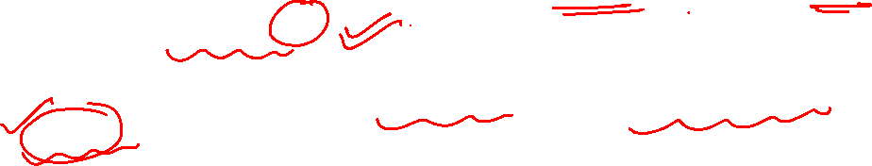
Graph Theory and its Applications UE21CS343AB3
Limitations Of Early (Basic ) PageRank
The PageRank theory holds that an imaginary surfer who is randomly clicking on links will eventually stop clicking.
The probability, at any step, that the person will continue following links is a damping factor d.
The probability that they instead jump to any random page is
1 - d.
Various studies have tested different damping factors, but it is generally assumed that the damping factor will be set around 0.85

Slide 18
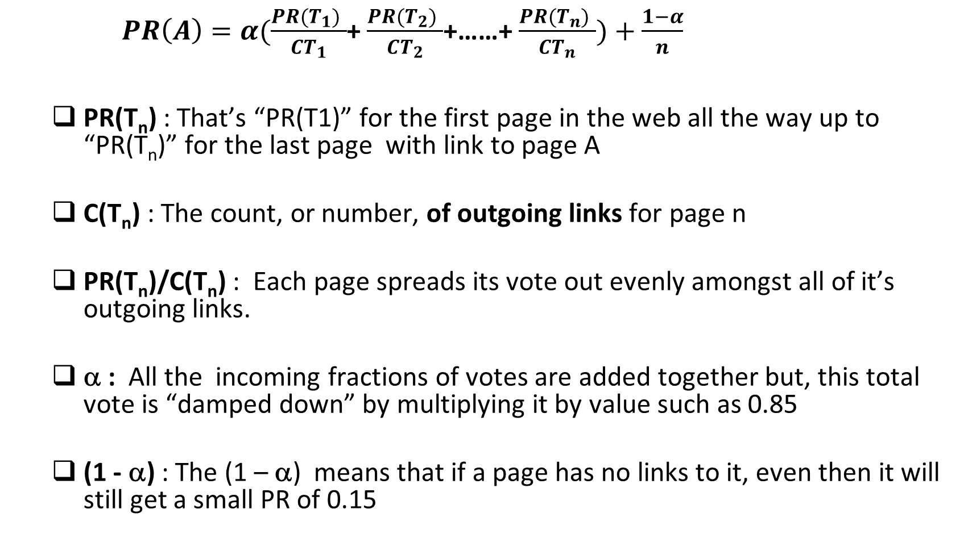
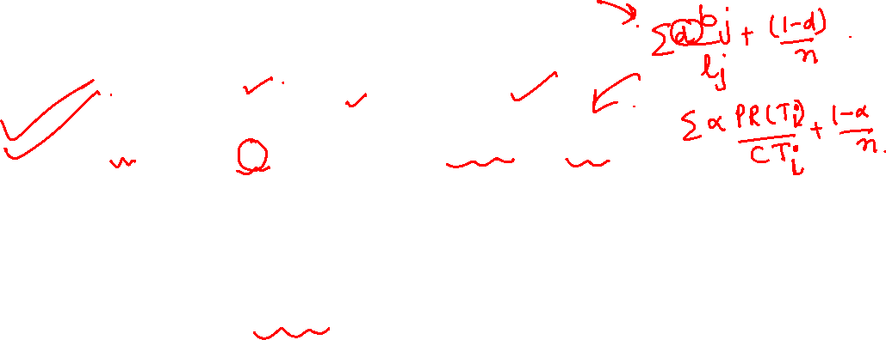
Graph Theory and its Applications UE21CS343AB3
PageRank Update Rule
$PR\left(A\right)=α(\frac{PR(T_{1}) }{CT_{1}}$+ $\frac{PR(T_{2}) }{CT_{2}}$+……+ $\frac{PR(T_{n}) }{CT_{n}})+\frac{1−α}{n}$
PR(T_{n}) : That’s “PR(T1)” for the first page in the web all the way up to “PR(T_{n})” for the last page with link to page A
C(T_{n}) : The count, or number, of outgoing links for page n
PR(T_{n})/C(T_{n}) : Each page spreads its vote out evenly amongst all of it’s outgoing links.
α : All the incoming fractions of votes are added together but, this total vote is “damped down” by multiplying it by value such as 0.85
(1 - α) : The (1 – α) means that if a page has no links to it, even then it will still get a small PR of 0.15

Slide 19

Graph Theory and its Applications UE21CS343AB3
Random Surfer Model and Spectral Analysis
PR(A) = α(PR(T1)/C(T1) +…+PR(Tn)/C(Tn)) + (1-α)/n
We are coming up with the same model !!

Slide 20
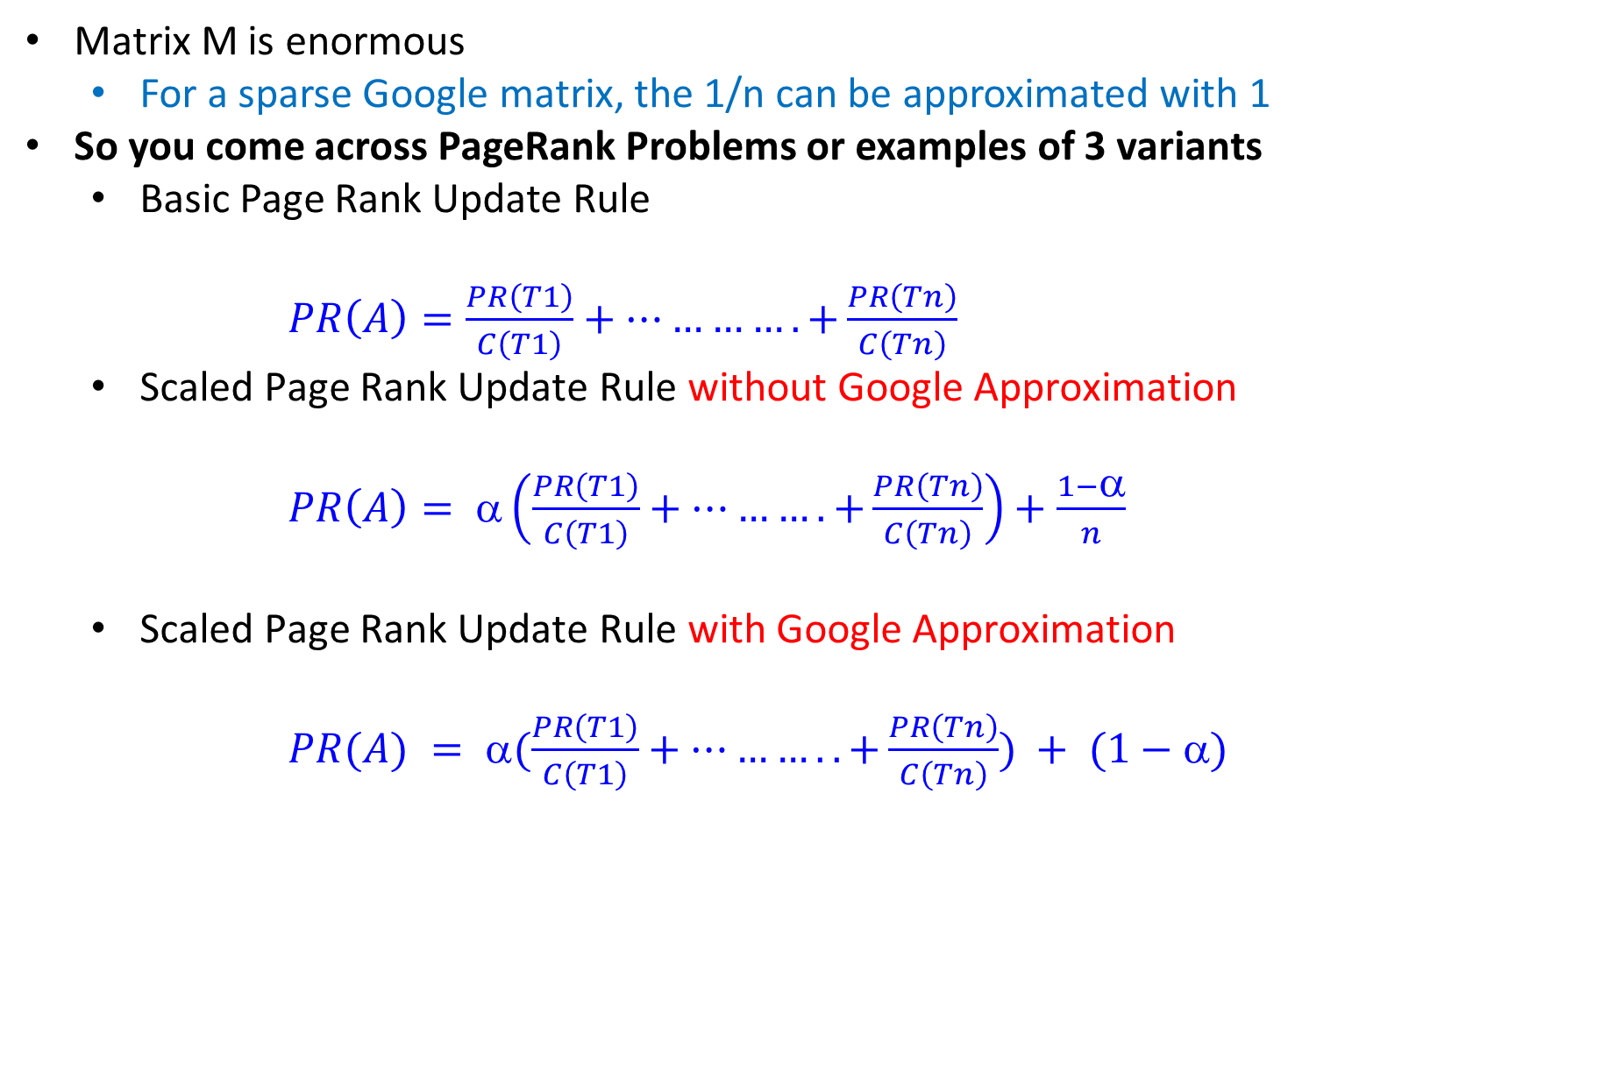

Graph Theory and its Applications UE21CS343AB3
Google Matrix Approximation and 3 Varieties Of PageRank Examples
Matrix M is enormous
For a sparse Google matrix, the 1/n can be approximated with 1
So you come across PageRank Problems or examples of 3 variants
Basic Page Rank Update Rule
$PR\left(A\right)=\frac{PR\left(T1\right)}{C\left(T1\right)}+………….+\frac{PR\left(Tn\right)}{C\left(Tn\right)}$
Scaled Page Rank Update Rule without Google Approximation
$PR\left(A\right)= α\left(\frac{PR\left(T1\right)}{C\left(T1\right)}+……….+\frac{PR\left(Tn\right)}{C\left(Tn\right)}\right)+\frac{1−α}{n}$
Scaled Page Rank Update Rule with Google Approximation
$PR(A) = α(\frac{PR\left(T1\right)}{C\left(T1\right)}+………..+\frac{PR\left(Tn\right)}{C\left(Tn\right)}) + (1−α)$

Slide 21
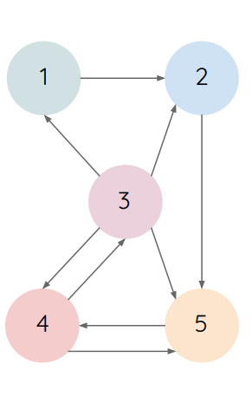
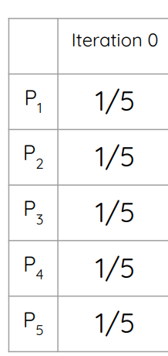
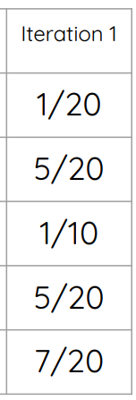
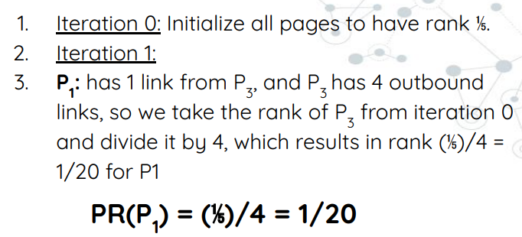
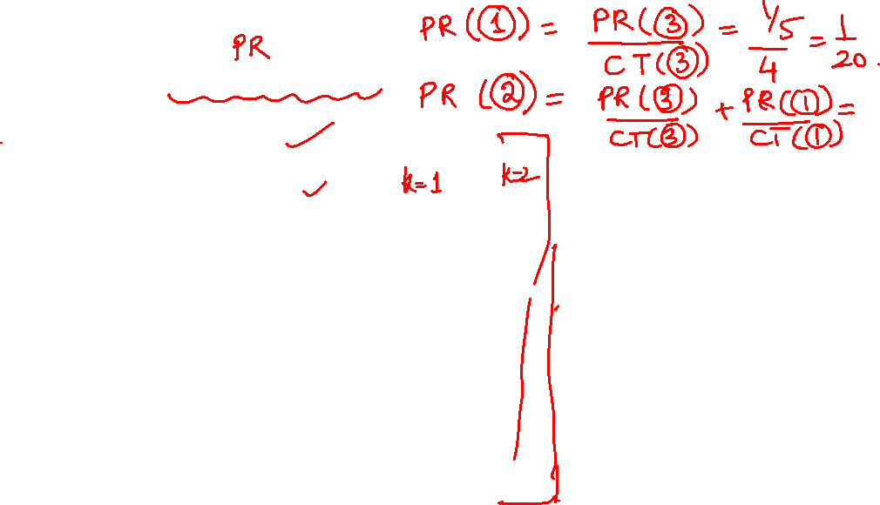
Example for basic update rule

Slide 22
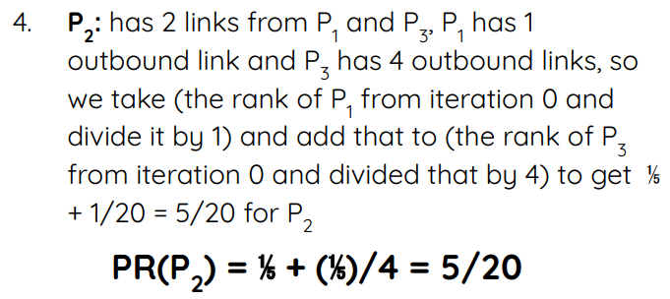
Example for basic update rule

Slide 23
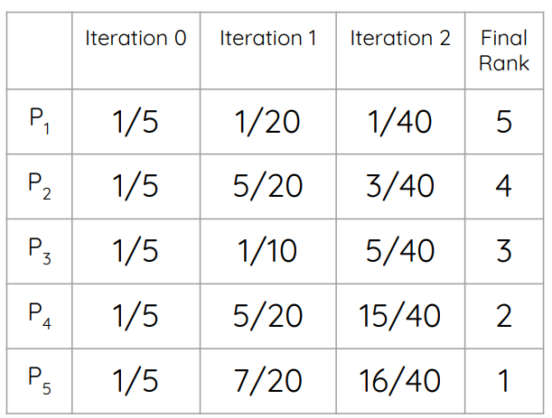
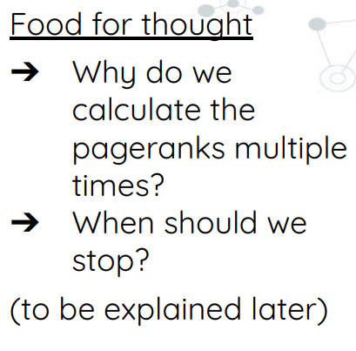



Slide 24
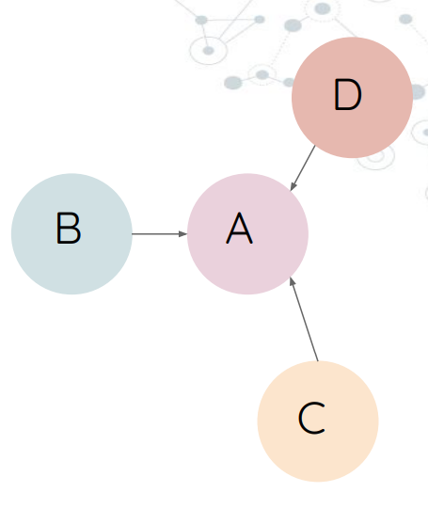
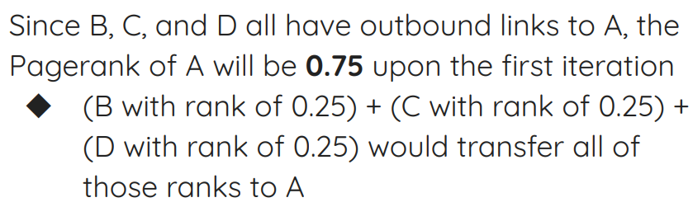
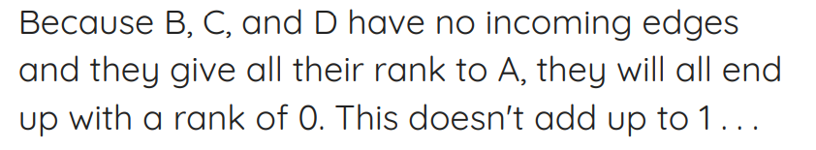


Slide 25
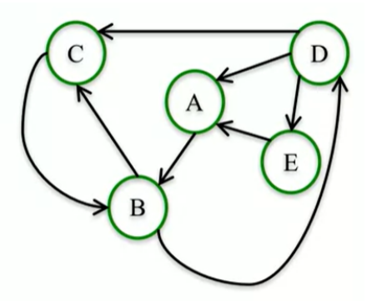
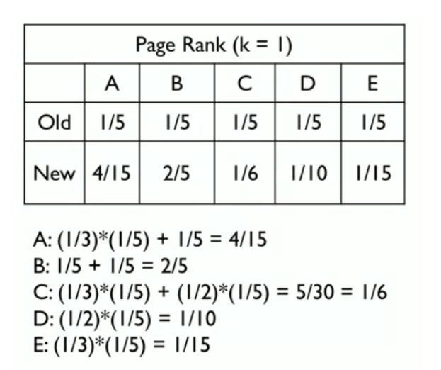
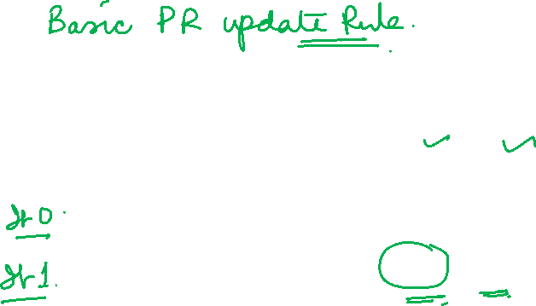
Another Example:

Slide 26
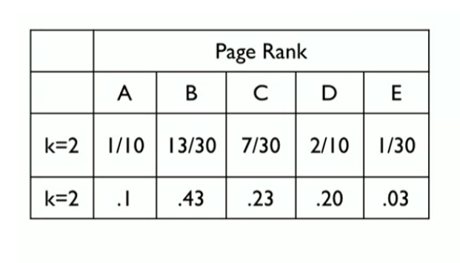

Another Example:

Slide 27

NETWORK ANALYSIS AND MINING
PageRank Scoring Using Basic PageRank Update Rule
 | Iteration 0 | Iteration 1 | Iteration 2 | Rank
A | ¼ | 1/12 | 1.5/12 = 0.125 | 4
B | ¼ | 2.5/12 | 2/12 = 0.166 | 3
C | ¼ | 4.5/12 | 4.5/12 = 0.375 | 1
D | ¼ | 4/12 | 4/12 = 0.333 | 2
A
B
C
D
Iteration 1 (damping not considered):
PR(A) = PR (C ) /Out(c ) = ¼ / 3 = 1/12
PR ( B ) = PR (A) / out (A ) + PR (C ) /Out(c )
= ¼ / 2 + ¼ / 3 = 2.5 /12

Slide 28
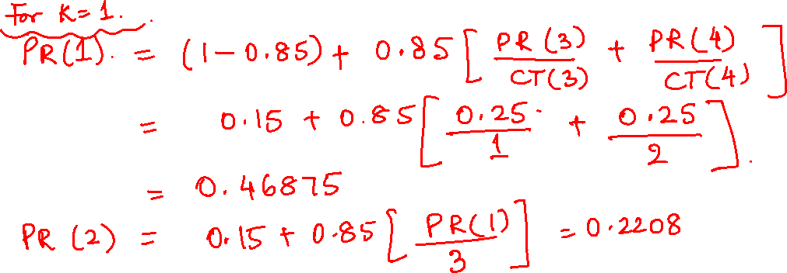

Graph Theory and its Applications UE21CS343AB3
PageRank Scoring Using Scaled PageRank Update Rule
Given : damping factor α =0.85 , initial rank = ¼ = 0.25
Use Google Approximations i.e.
No need to divide (1- α) by number of nodes !
1
3
2
4

Slide 29
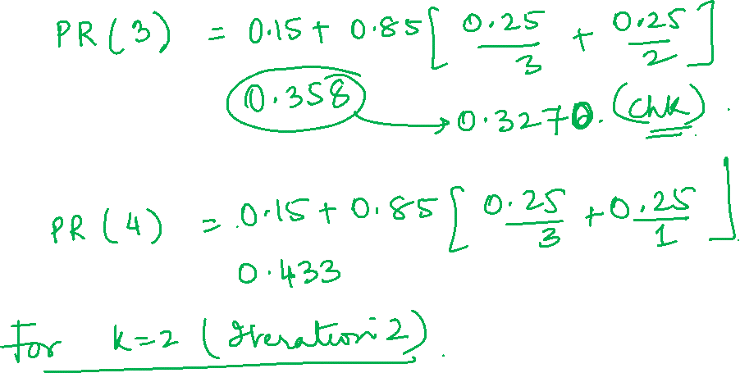

Slide 30
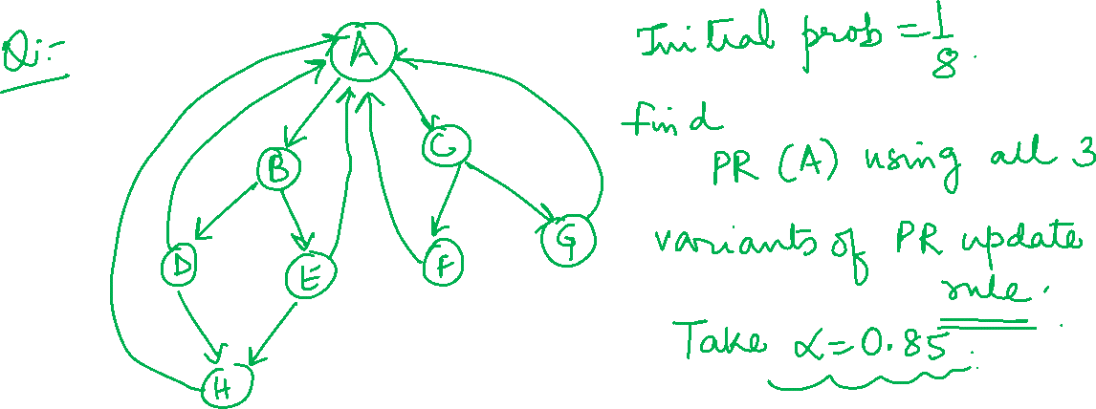

Slide 31
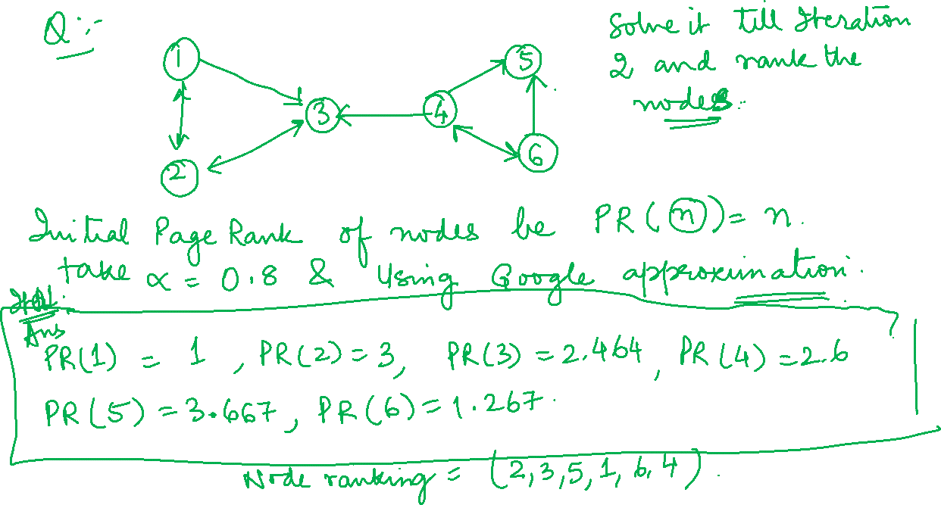

Slide 32
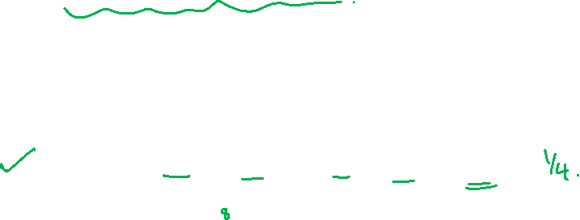
Graph Theory and its Applications UE21CS343AB3
PageRank Scoring Using Scaled PageRank Update Rule
1
3
Given : damping factor α =0.5 , initial rank = ¼ = 0.25
Use Google Approximations i.e.
No need to divide (1- α) by number of nodes !
If C(n) = no of out links of n , C(1)=3, C(2) = 2, C(3) = 1, C(4) =2
Iteration 0 : PR(1)=PR(2)=PR(3) = PR(4) = 0.25
Iteration 1 (with damping):
PR(1) = (1-0.5) + 0.5* (PR(3 ) /C(3 ) + PR(4) / C(4) )
= 0.5 + 0.5 *(0.25/1 + 0.25/2) = 0.6875
PR(2) = 0.541 , PR(3) = 0.667 , PR(4) = 0.604
Iteration 2 : We plug in these found PageRank and continue…
At some iteration, we will reach steady state …
2
4

Slide 33
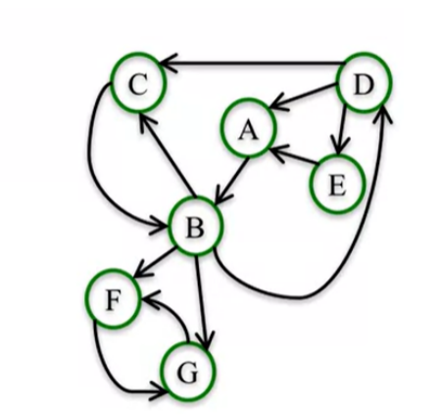
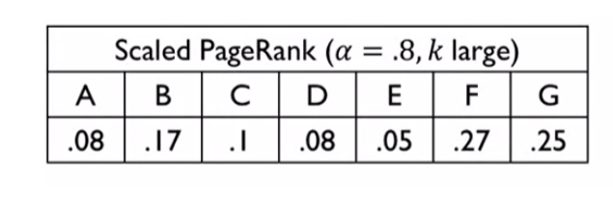
Scaled Page rank example
Lets make a small change to this network adding two nodes, F and G, where B points to both of those nodes, and then they point to each other as depicted in the figure below.

Slide 34
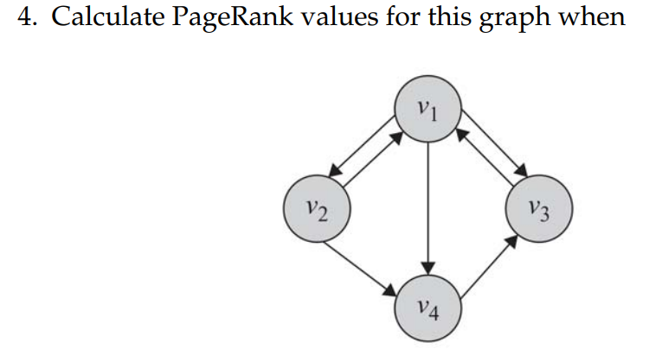
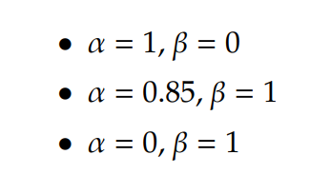
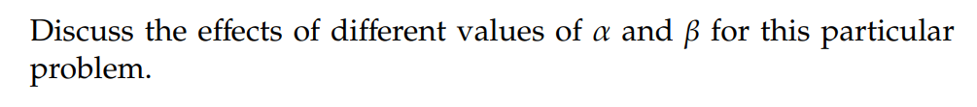
Page Rank example

Slide 35
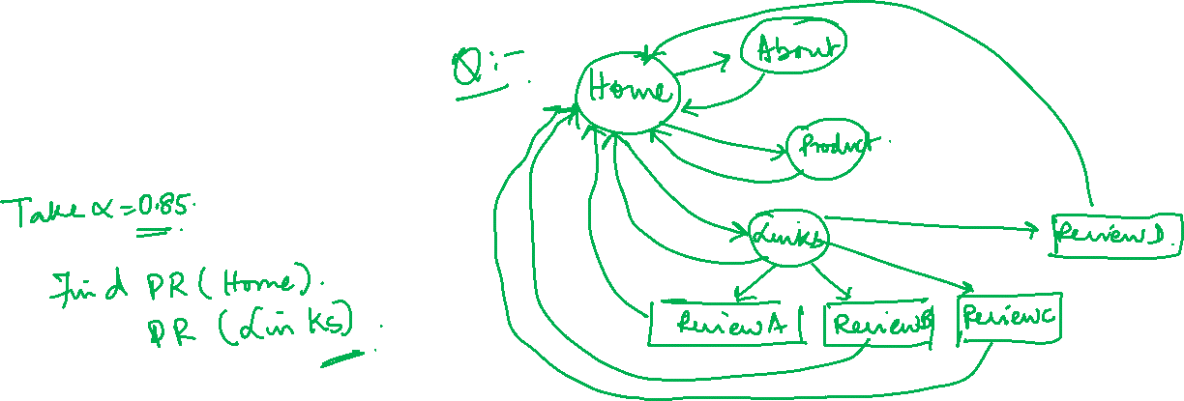
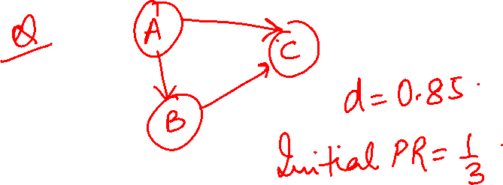
THANK YOU

